Slide 1
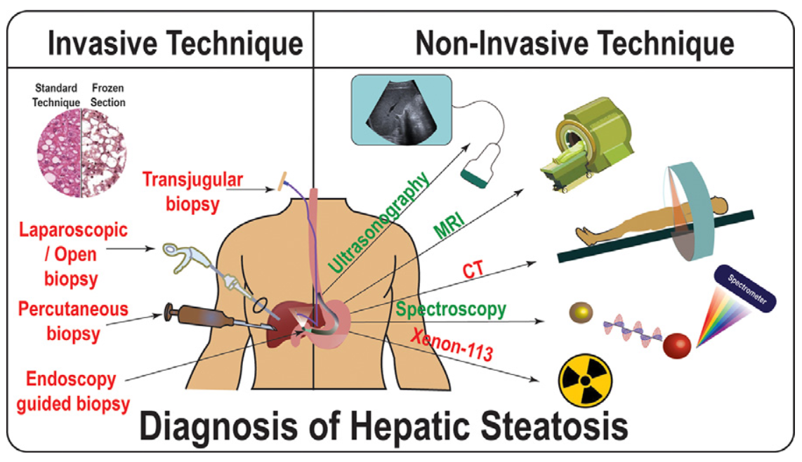
Liver Biopsy |  | Sedation | Size | Pressures | Indications | Pros | Caveats
IR | Percutaneous | None Local Conscious | Adequate | None | Default | Tissue sufficient for diagnosis and assessment of fibrosis | No pressure measurements Patient discomfort
 | Transjugular | None Conscious MAC | Variable | RHC FHVP WHVP HVPG | Ascites Coagulopathy | Less bleeding risk Allow for pressure measurements | Tissue sample closer to capsule may overestimate fibrosis
GI | EUS | MAC GA | Small to medium | FHVP PVP PPG | Need EGD |  | May not be feasible in presence of gastric varices or ascites
SURG | Laparoscopic | GA | Large | None | Need surgery (i.e. CCY) | Large sample Direct visualization | No pressure measurements Invasive Requires surgery Longer recovery time

